Slide 1

Life Expectancy In the Twin Cities Metro
Alynda Her
James Dale
Kat Heron

Slide 2
What factors impact life expectancy in the Minnesota Twin Cities metro counties?
Data was cleaned to only include Anoka, Carver, Dakota, Hennepin, Ramsey, Scott, and Washington counties.

Slide 3
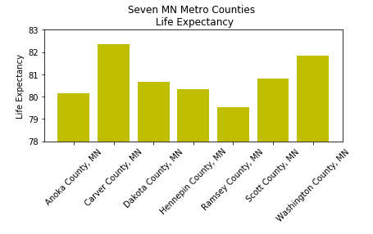
Life Expectancy
The CDC defines ‘Life Expectancy at Birth’ as “the average number of years that a hypothetical group of infants would live at each attained age if the group was subject, throughout its lifetime, to the age-specific death rates prevailing for the actual population in a given year.” https://www.cdc.gov/nchs/products/databriefs/db244.htm#ref1
Our data came from National Center for Health Statistics, National Vital Statistics System, US Small-area Life Expectancy Estimates Project (USALEEP)
https://www.cdc.gov/nchs/nvss/usaleep/usaleep.html

Slide 4
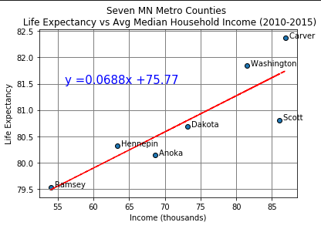
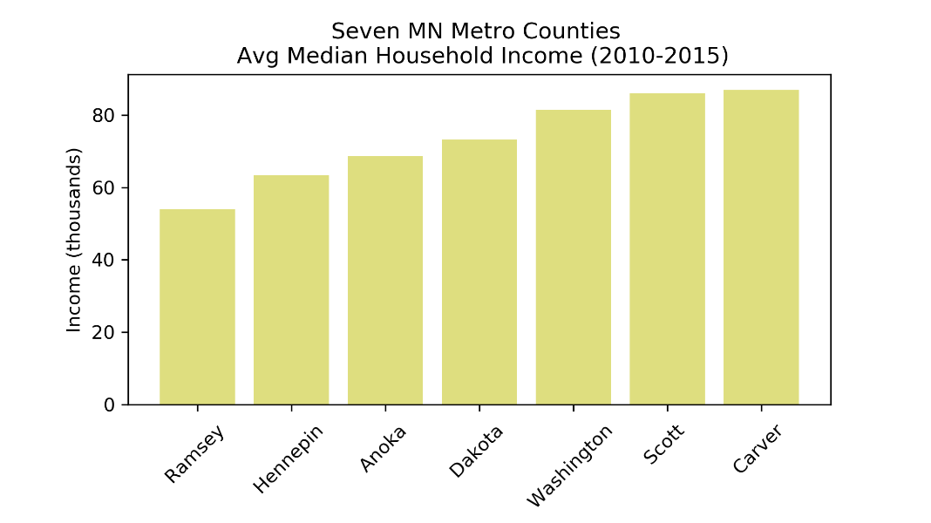
Median Household Income https://www.census.gov/programs-surveys/saipe/data/datasets.2010.html

Slide 5
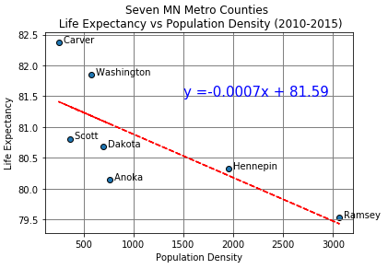
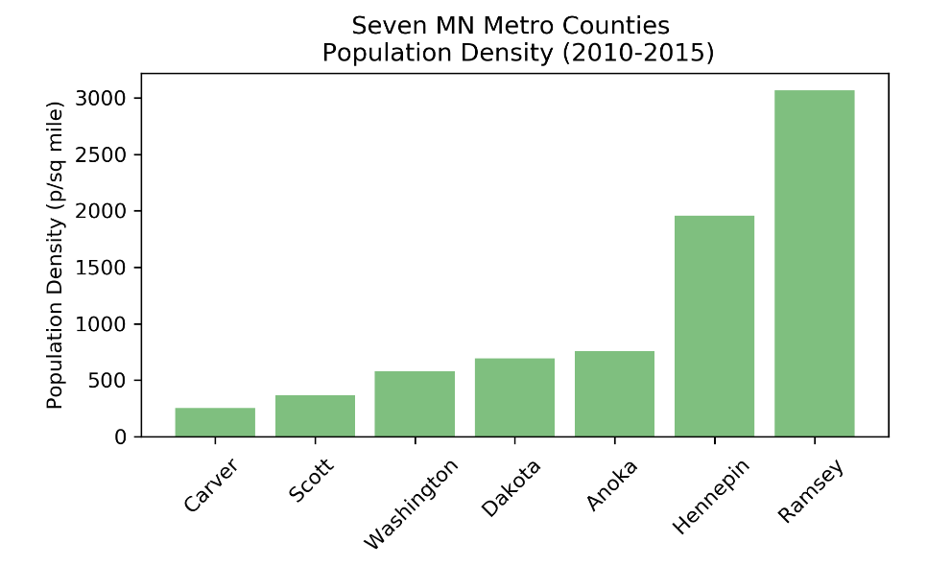
Population Density https://mn.gov/admin/demography/data-by-topic/population-data/our-estimates/

Slide 6
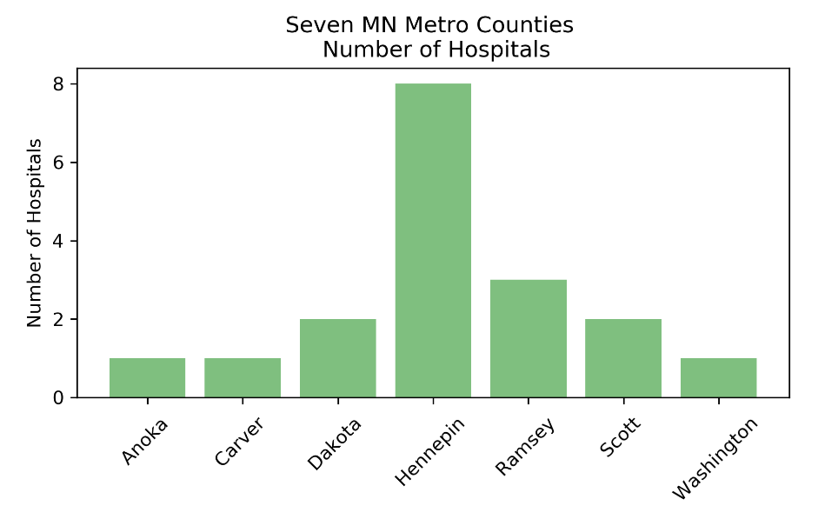
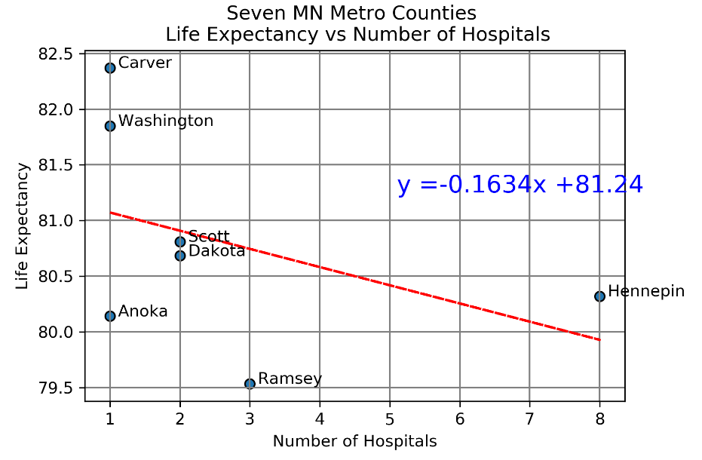
Number of Hospitals https://data.medicare.gov/data/hospital-compare

Slide 7
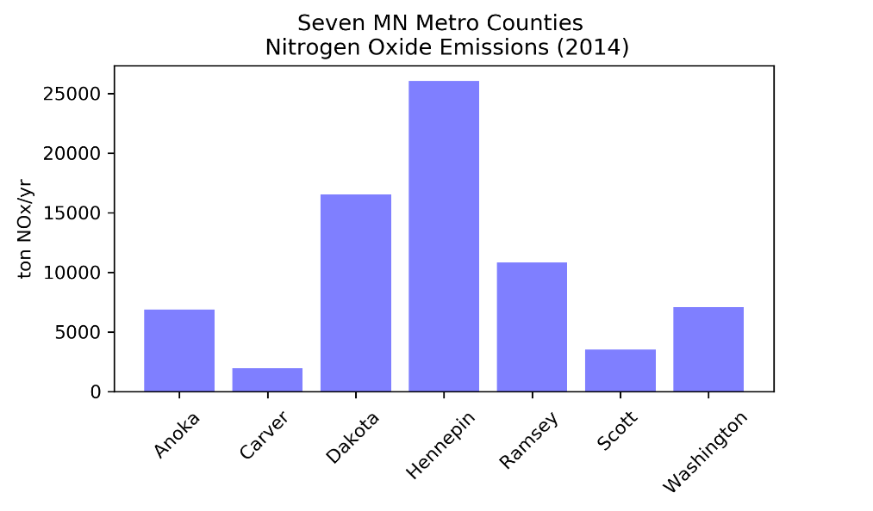
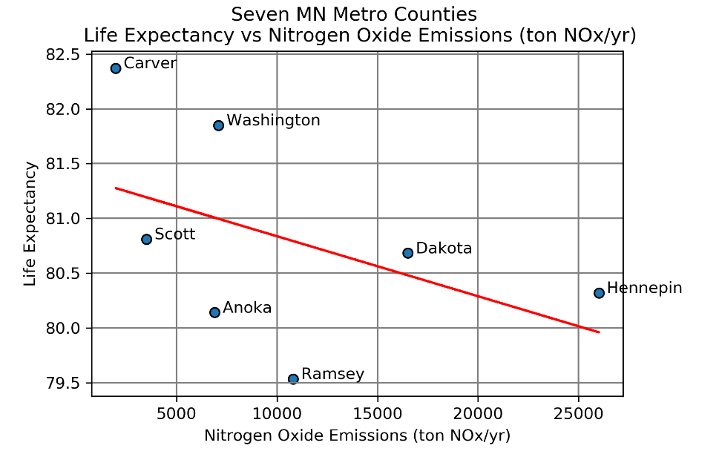
Nitrogen Oxide Emissions https://www.pca.state.mn.us/air/statewide-and-county-air-emissions

Slide 8
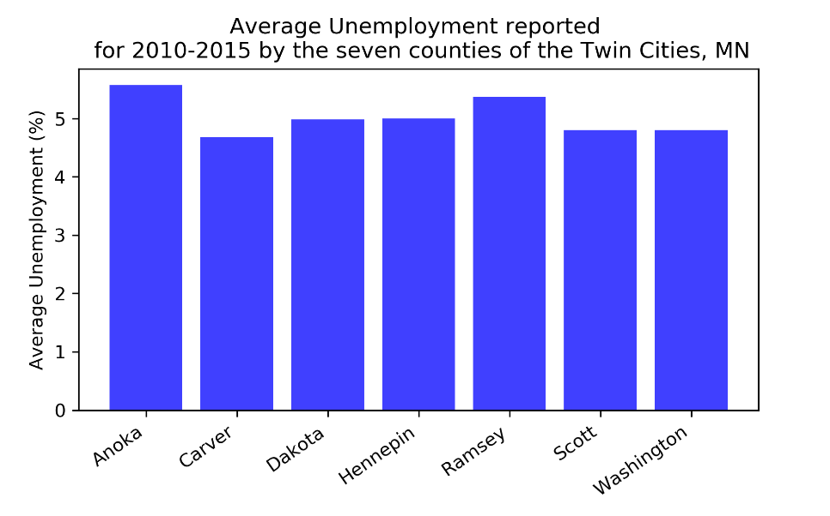
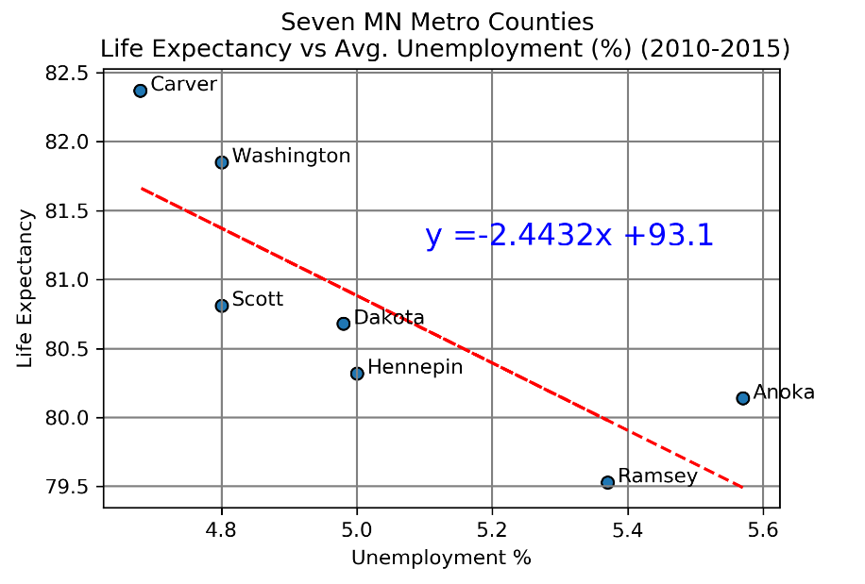
Unemployment https://apps.deed.state.mn.us/lmi/laus/Results.aspx?geog=2704000003%2c2704000019%2c2704000053%2c2704000123%2c2704000139%2c2704000163&adjusted=0&periodtype=03&resultset=3&startyear=2011&endyear=2020

Slide 9
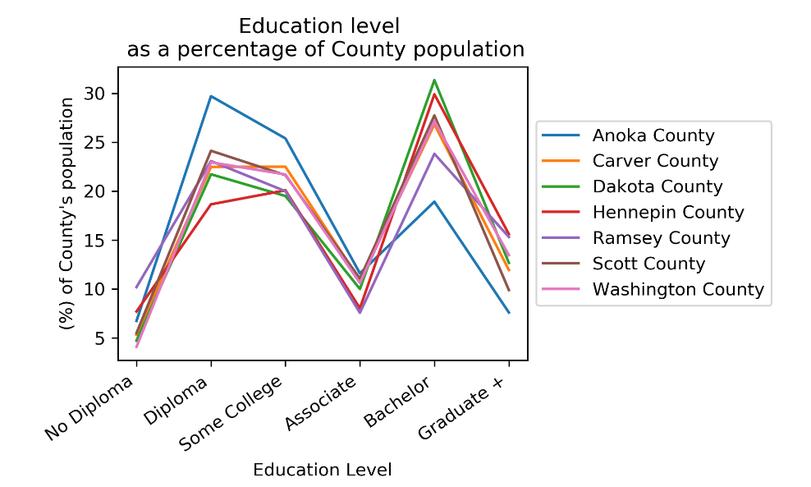
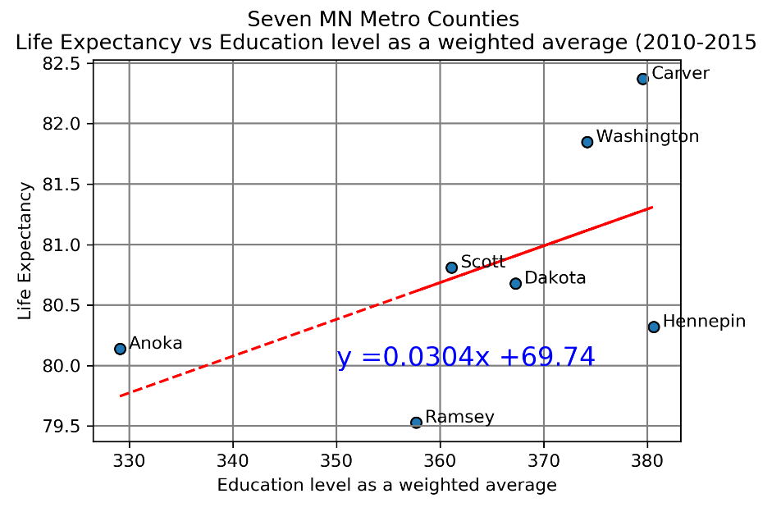
Highest Education Level Attained https://stats.metc.state.mn.us/data_download/DD_Years.aspx?datasource=cen&comms=&subjects=%27POPEDULEV%27&level=region

Slide 10
Links between links?

Slide 11
Factors and Hypotheses
Median Household Income
Positive correlation
Population Density
Negative correlation
Number of Hospitals
Positive correlation
Emissions
Negative correlation
Unemployment
Negative correlation
Education Level
Positive correlation
Positive correlation
No correlation
No correlation
No correlation
Negative correlation
No correlation

Slide 12
Overall Conclusions
Link | R-value | P-value | Standard Error
Average Income | 0.8558 | 0.014 | 0.0186
Education | 0.5471 | 0.2038 | 0.0208
Number of Hospitals | -0.4151 | 0.3545 | 0.16018
Emissions | -0.466 | 0.292 | 5.00E-05
Population Density | -0.7373 | 0.0586 | 0.00029
Unemployment | -0.8068 | 0.0283 | 0.8002
Of the factors that we researched, average income has the strongest positive correlation to life expectancy and unemployment is the strongest negative correlation to life expectancy.

Slide 13
Questions to further research
Would we find more varying data in counties outside the metro area?
What if we chose randomized samples of counties in Minnesota?

Slide 14
Questions?

